Slide 1
Computer Architecture: Performance & Power
Dr. Colin O’Flynn

Slide 2
Lectures
How does a program run on a machine?
How do you compile from high-level code to machine code?
How does the machine run? (Control Flow)
How does the machine store, access, and control data?
How does the machine execute instructions?
How is execution made more efficient?
How do we measure execution? What is our limit of performance?

Slide 3
How to measure performance?
Clock speed?
Instructions Per Second?
Instructions Per Cycle?
Power Used?
Something Else?

Slide 4
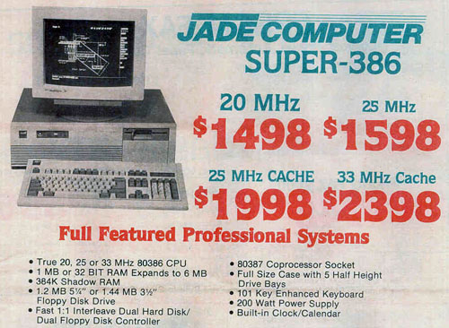
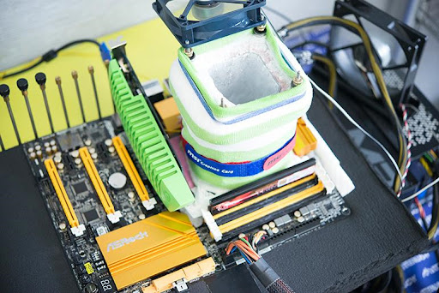
Clock Speed

Slide 5
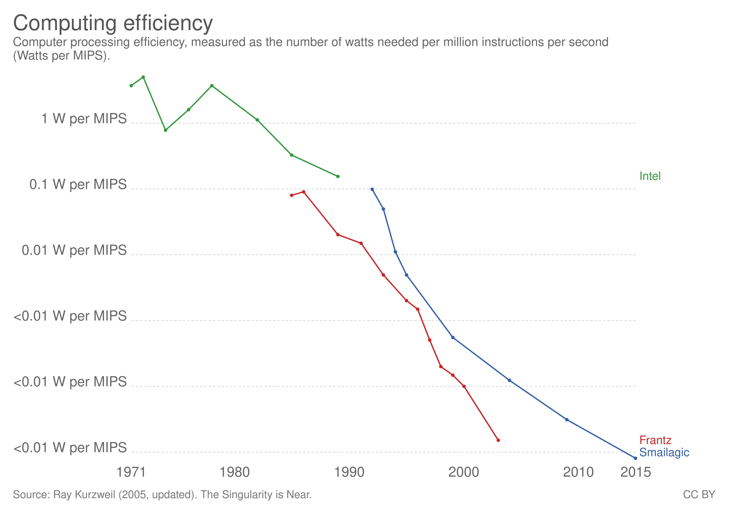
Instructions Per Second
Rather than pure Hz – measure how many instructions happen in that time.
Slightly better, but no idea what those instructions do.

Slide 6
Considerations around Performance
We said memory latency can be a driving factor in performance
Consider different workloads:
Sorting a large dataset
Calculating a 3D render path
Calculating the digits of Pi

Slide 7
What are we trying to benchmark anyway?
Evaluating performance as a user:
We care about benchmark or results ($ / performance)
Evaluating performance as a developer / engineer:
We care about our program (instrumenting, etc.)
This is normally called profiling

Slide 8
Workload-Based
Most useful benchmarks have some somewhat relatable workload

Slide 9
Common Benchmarks
Dhrystone:
Old integer benchmark, not a realistic workload
Whetstone:
Float-point focused, tries to improve on Dhrystone
EEMBC CoreMark
Embedded focused – tries to compare various operations you might do on embedded systems (and most common/useful for us)
SPEC CPU
Desktop/Server CPU evaluation – various more real-life workloads
PassMark CPU Mark
Commercial benchmark tool – widely used in reviews, evaluations, etc

Slide 10
Embedded Performance Measurements
How do you select a microcontroller?
Base it on peripherals you need (communication etc), but then what about the code you are running?
Machine Learning?
Machine Vision?
Complex math?
How much compute is needed?

Slide 11
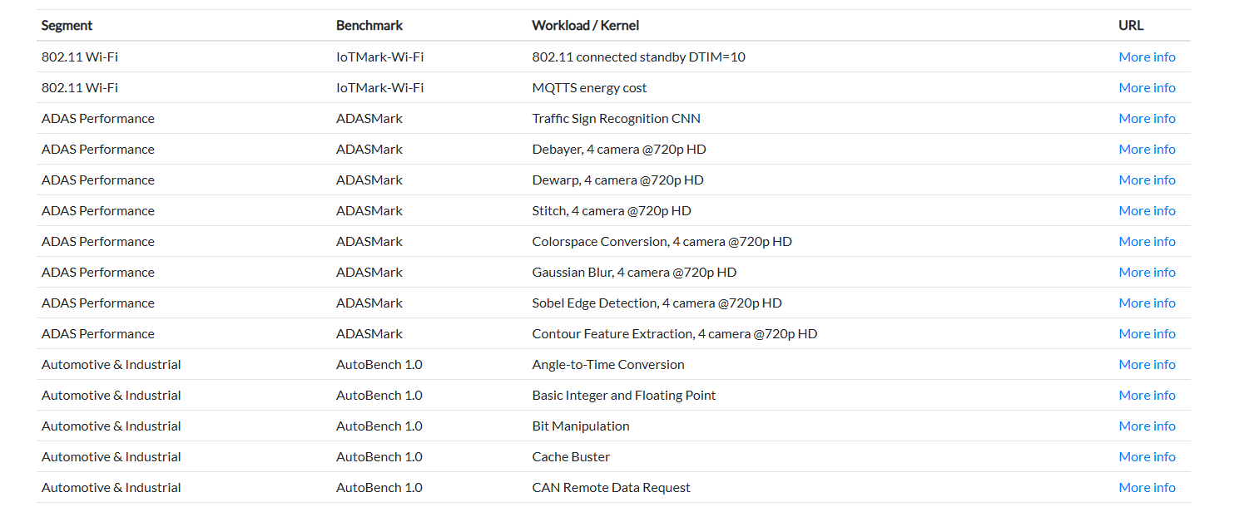
CoreMark
Standard embedded benchmark, various “kernels” you can use:
https://www.eembc.org/products/kernels.php

Slide 12
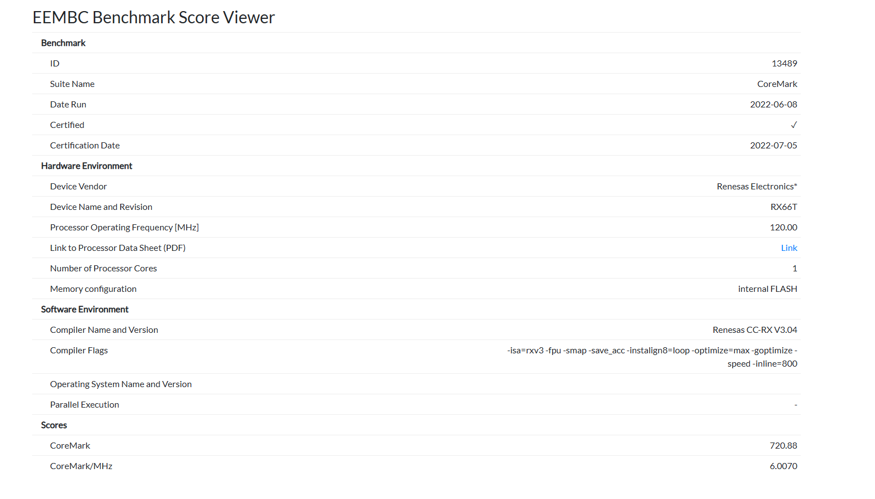
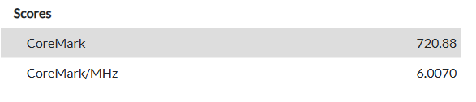
CoreMark Results
E.g., : https://www.eembc.org/viewer/?benchmark_seq=13489

Slide 13
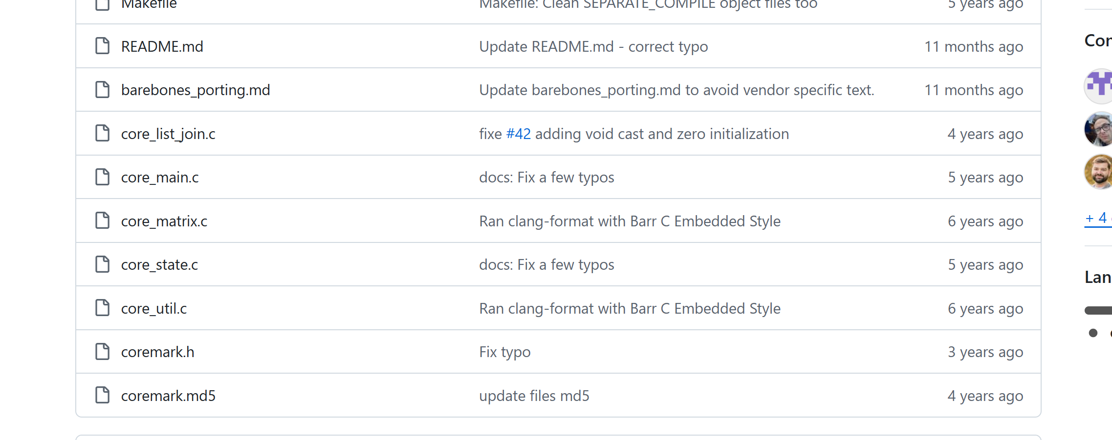
Running CoreMark
https://github.com/eembc/coremark

Slide 14
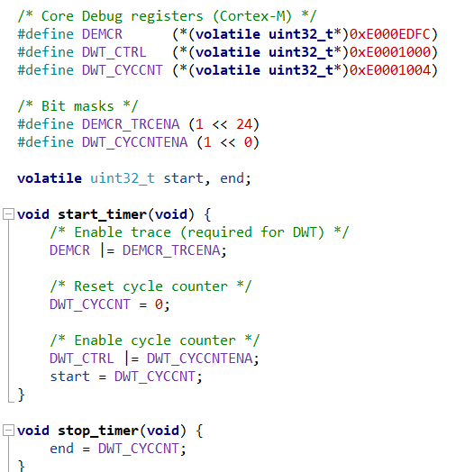
Measuring Cycles on Embedded Targets
The API at the right uses the Cycle Counter
This is very handy when comparing execution time on embedded systems – most Arm targets support this!

Slide 15
Power Usage
So far – we’ve considered mostly selecting a processor based on e.g., price, availability, etc.
In real life, what is our limiting factor?
→ POWER

Slide 16
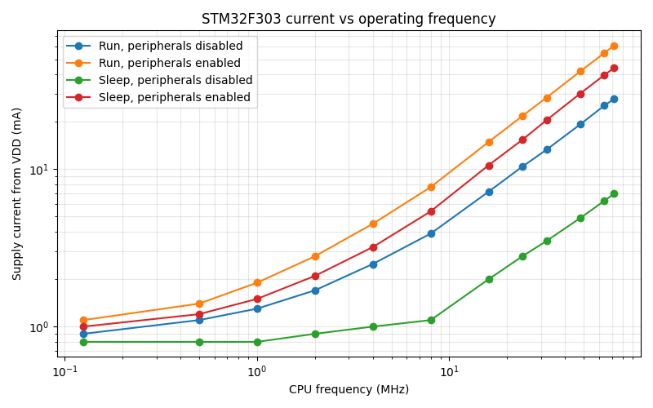
Power Usage vs. Performance

Slide 17
Dynamic Power Consumption
Switching all those transistors that make up our microcontroller mean switching some capacitance from a logic-0 to a logic-1
General formula for power usage with this is:
P_{dynamic} = C × V² × f
C = capacitance
V = Voltage
f = Frequency

Slide 18
Factors Impacting Power Usage
Capacitance defined by node size
Newer (smaller) processes have less capacitance as have smaller dies
Voltage has a major (square) impact
Newer (smaller) often run at lower voltages (5V → 3.3V → 1.8V → 1V)
Many microcontrollers have a lower core voltage and a higher I/O voltage
Frequency should have a linear impact
This is one thing you can easily control

Slide 19
Power Targets
Power (W) = Instantaneous Consumption
Energy (J) = Total consumer over time
Often have some combination of limits of instantaneous power and energy

Slide 20
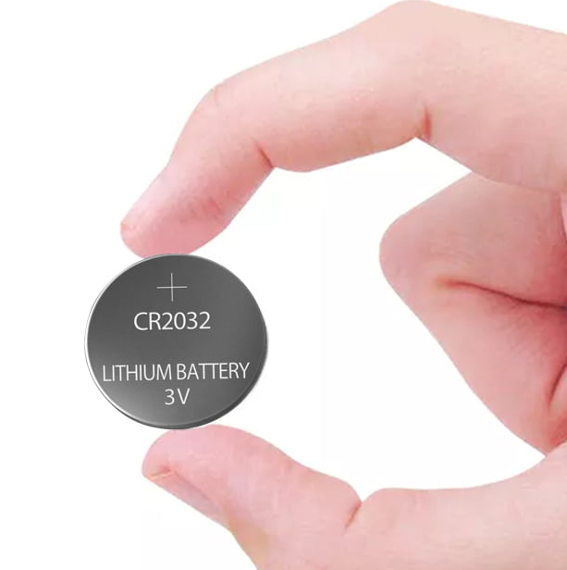
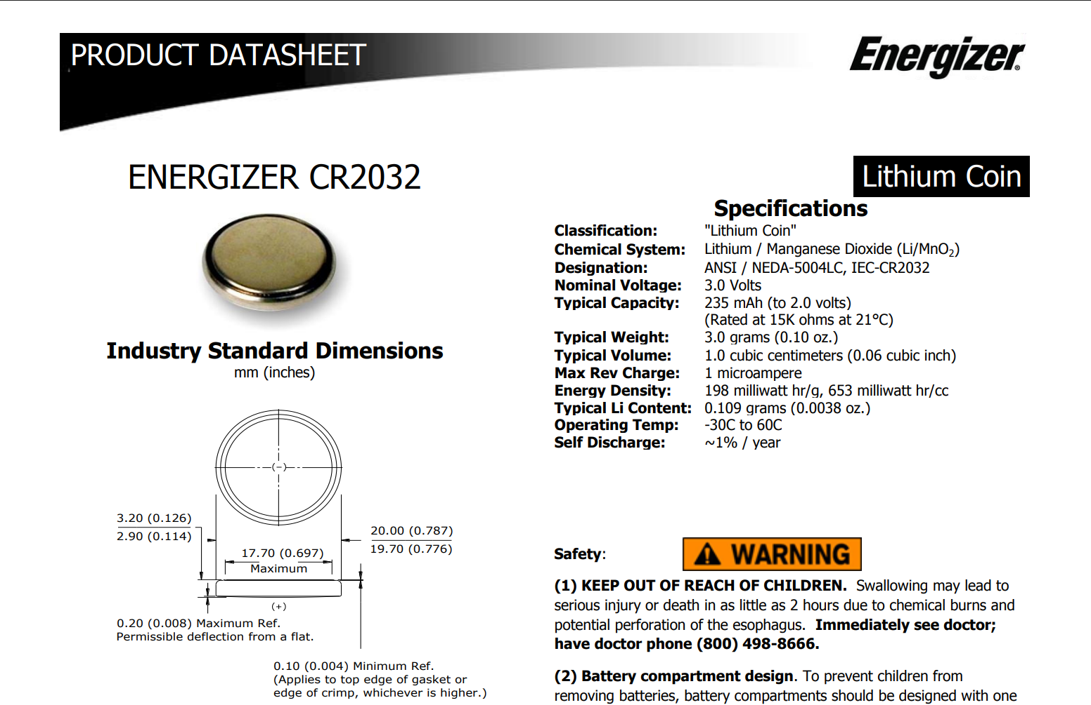
e.g., CR2032 Coin Cell
https://data.energizer.com/pdfs/cr2032.pdf

Slide 21
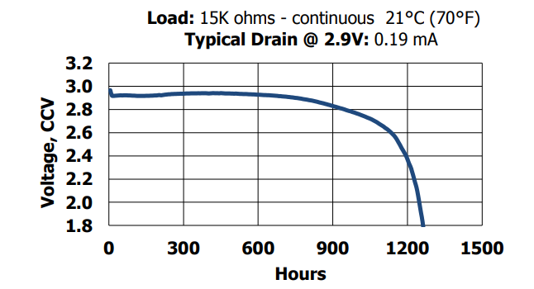
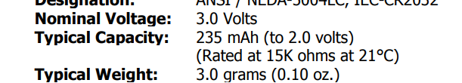
Simple Battery Power Measurement
235 mAh meaning:
1 mA for 235 hours
100 uA for 2350 hours
10 mA for 23.5 hours

Slide 22
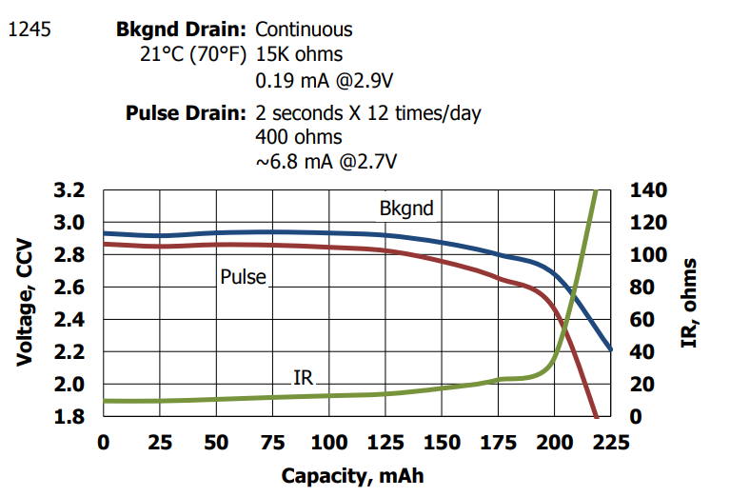
…kinda

Slide 23
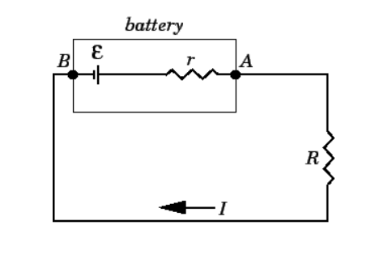
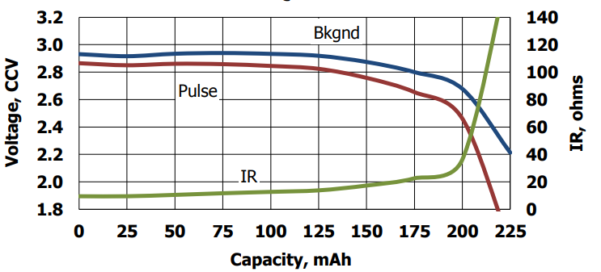
Other Consideration: Internal Resistance

Slide 24
e.g., CR2032 @ 125mAh drawn
Open circuit (OC) voltage ~2.8V
Internal Resistance (IR) ~18 ohms
If drawing 50 mA from battery
V = I R = (0.05)(18) = 0.9V
Vload = 2.8 – 0.9 = 1.9V

Slide 25
Pulse Usage: Capacitor Banks
Common to have a capacitor in parallel with battery to have pulse current capability
This capacitor has a low energy stored however. E.g.:
Assuming 10uF capacitor @ 2.8V
E = ½ × C × V²
= 0.5 × 10E-6 × 2.8²
= 39.2 uJ
^{mAh = Joules / (V × 3.6)}
= 0.00000778 mAh
= 0.028008 mAs

Slide 26
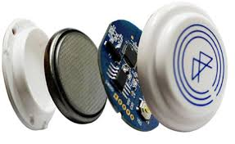
Pulse Usage: Explains common sensor cycles
When designing devices powered from small coin cells (think sensors), you often need to use high-energy / sleep cycles.
Not only for total power saving, but to deal with limited total current.

Slide 27
Typical Low-Power Modes
Most microcontrollers have some combination of:
Active (normal) mode
Ability to turn on/off peripherals
A low-power mode that keeps everything alive (“sleep” normally)
SRAM power is ON
A super-low power mode that kills most things (“stop” normally)
May even turn off SRAM → RAM invalid
Often a mode that leaves a “Real Time Clock” (RTC) Active

Slide 28
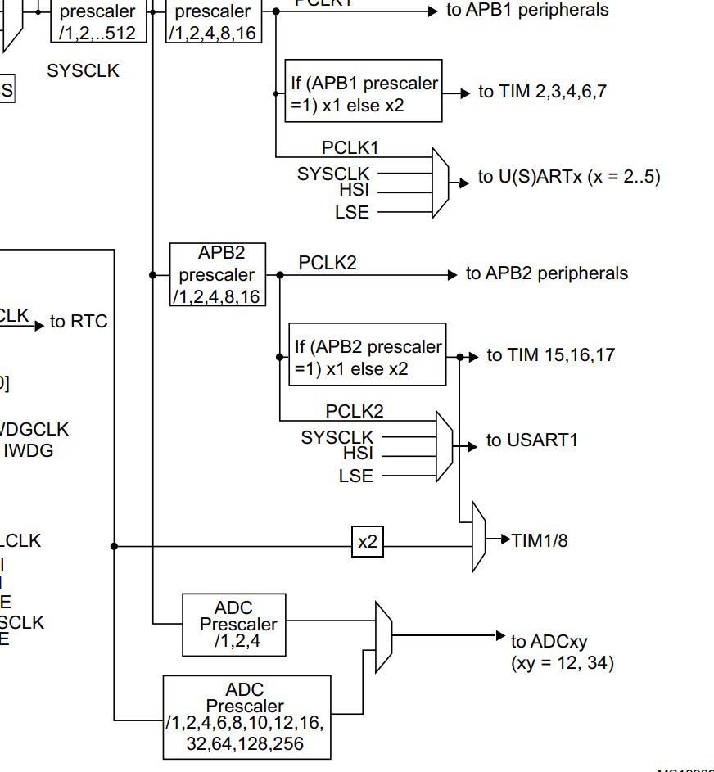
e.g., STM32F3 Clock Gating
Most microcontrollers allow you to turn on/off clocks to peripherals
Many devices have them off by default
This is a common problem if you have a device not working

Slide 29
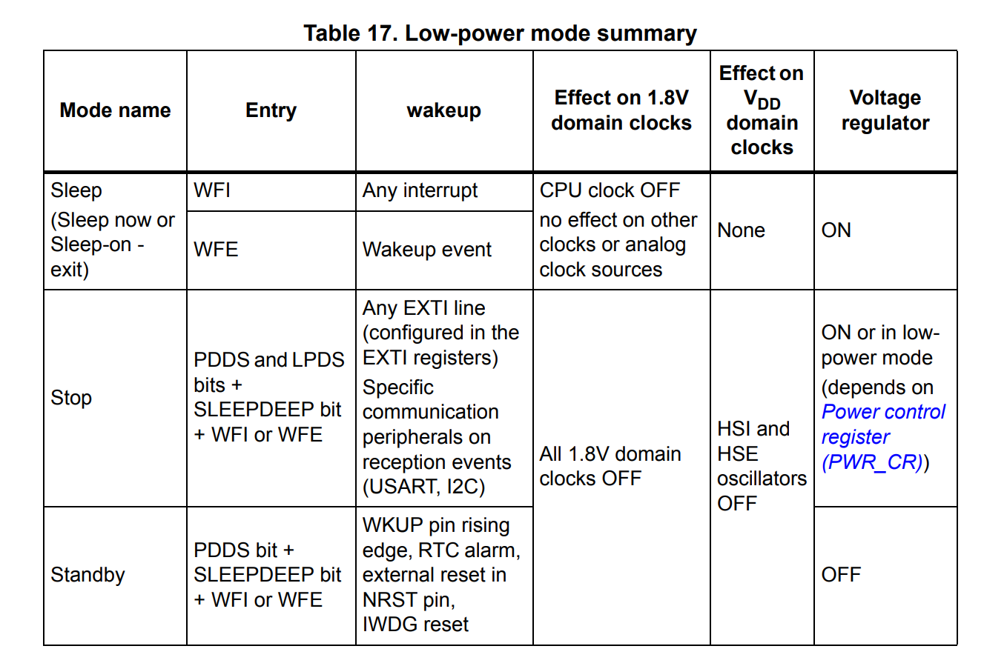
e.g., STM32F3 Low-Power Modes

Slide 30
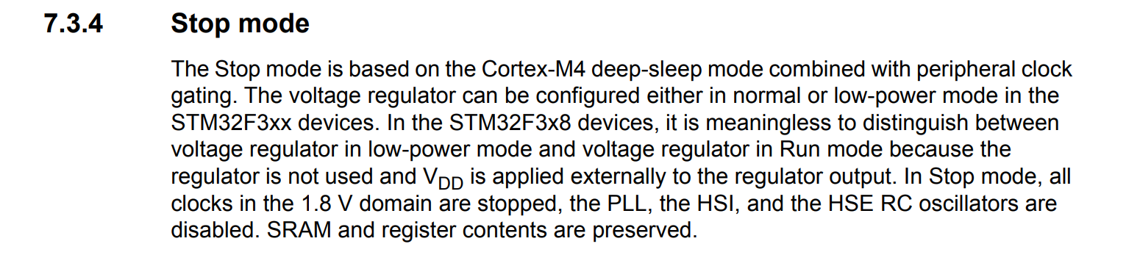
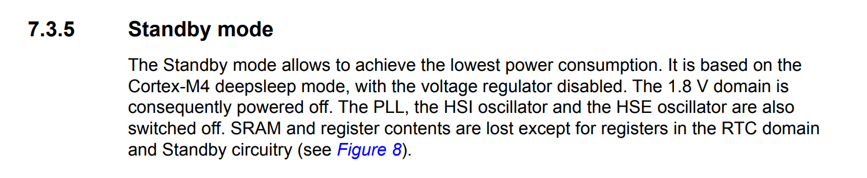
Always check specifics

Slide 32
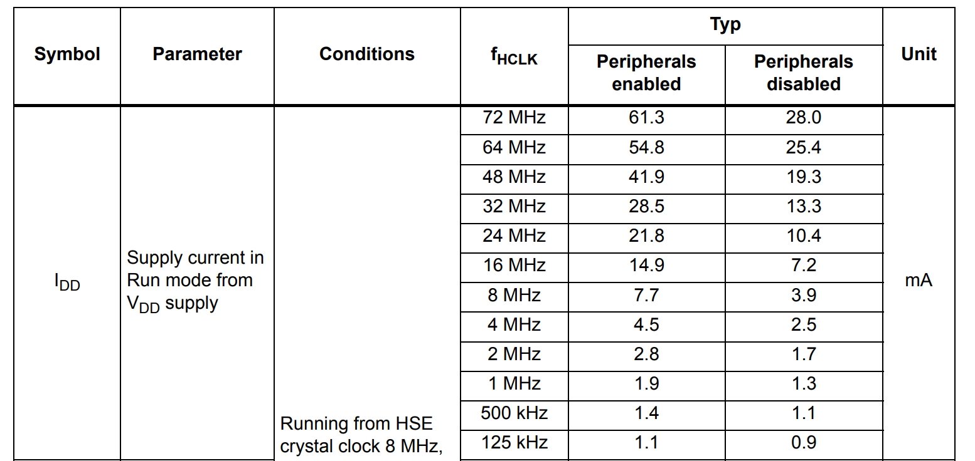
STM32F303: Run Mode vs. Freq

Slide 33
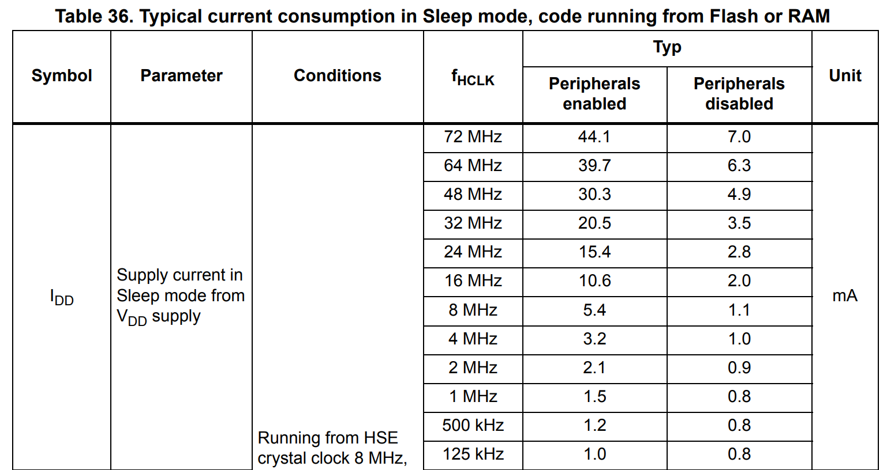
STM32F303: Sleep Mode vs. Freq

Slide 34
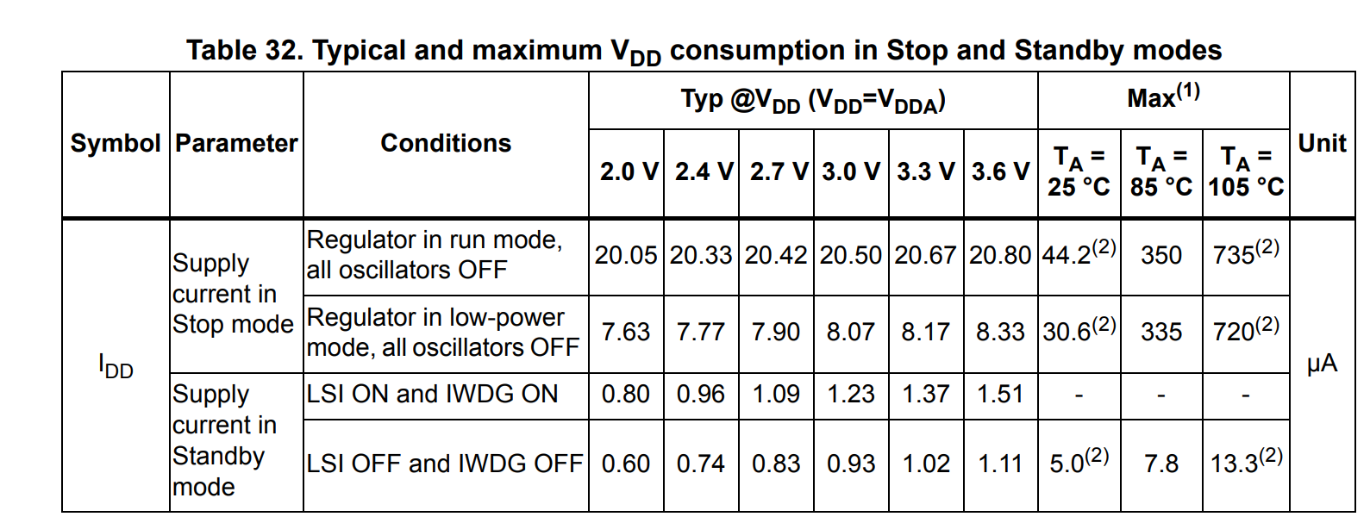
Stop & Standby Comparison

Slide 35
CR2032 Battery Callback
Our 235 mAh battery would last:
Mode | Condition | Current (Typ) | CR2032 Life (Ideal)
Run | 72 MHz, Peripherals Disabled | 28 mA | 8.4 hours
Run | 1 MHz, Peripherals Disabled | 1.3 mA | 181 hours / 7.5 days
Sleep | 72 MHz, Peripherals Disabled | 7.0 mA | 34 hours / 1.4 days
Sleep | 0.125 MHz, Peripherals Disabled | 0.8 mA | 294 hours / 12.2 days
Stop | Regulators in run, oscillators off | 21 uA | 1.3 years
Standby | IWDG On | 1.4 uA | 20 years

Slide 36
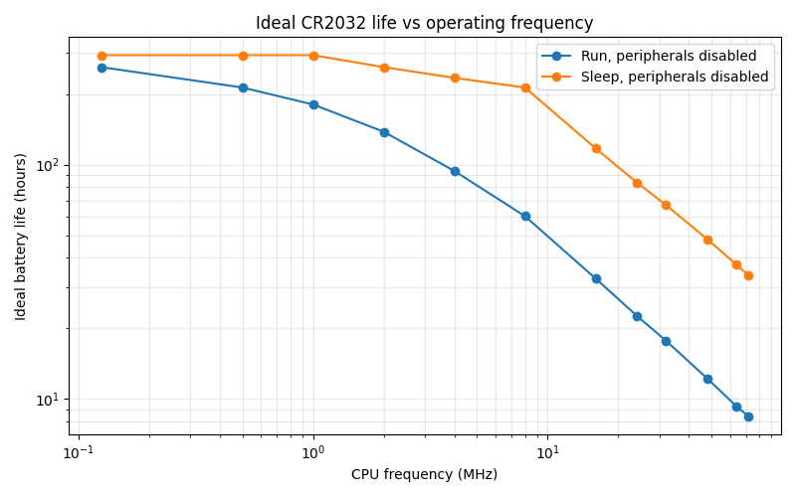

Slide 37
Optimizing for Lowest Total Power
Most applications require occasional (at least) wakeup to do something
We could “run fast” == higher power, but more done/second
We could “run slow” == low power, but less done/second
NEVER MAKE ASSUMPTIONS. CHECK FOR DATASHEET DETAILS.

Slide 38
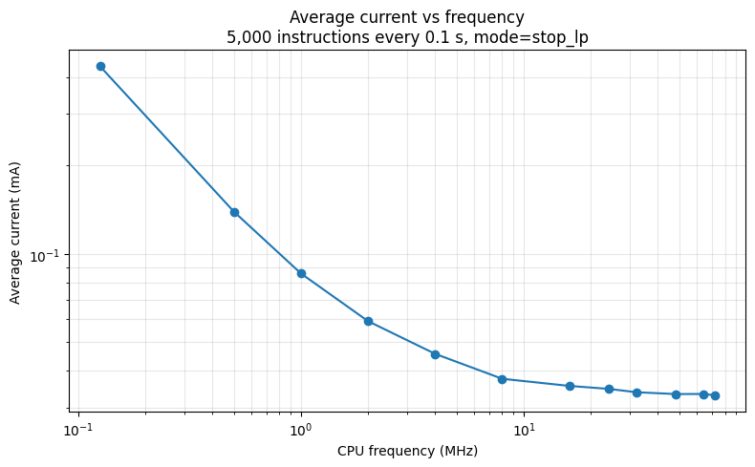
Optimizing for Lowest Total Power
Also need to consider:
Time to enter stop mode
Time to wakeup from stop mode
Graph at right accounts for this & adds power of running for 5000 cycles at different frequencies
https://colab.research.google.com/drive/1sOcllVgW9yIy8QLc2_68LVZ1Cn8YiFNr?usp=sharing

Slide 39
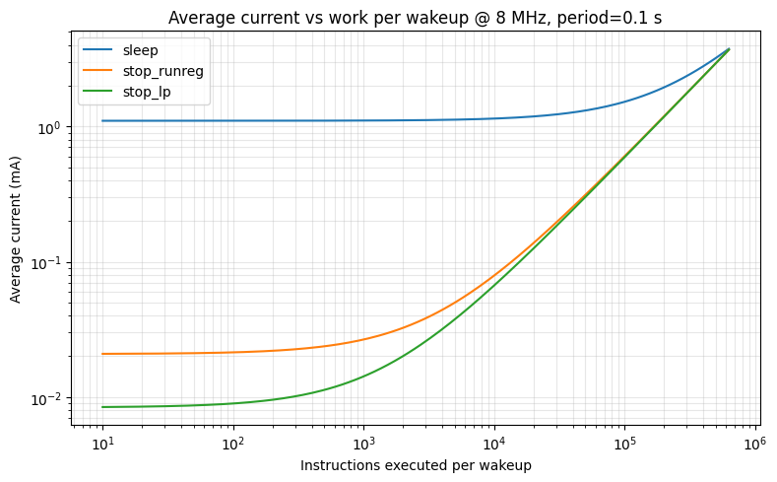
Optimizing for Lowest Total Power
Graph at right now shows how effect of wakeup/sleep time should be accounted for!
https://colab.research.google.com/drive/1sOcllVgW9yIy8QLc2_68LVZ1Cn8YiFNr?usp=sharing

Slide 40
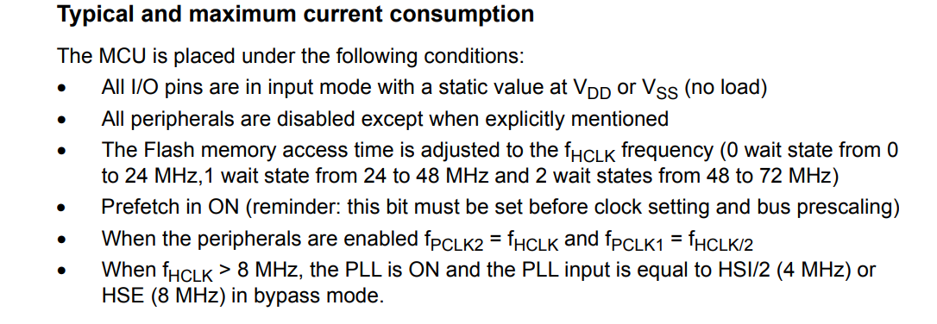
Targeting Low Power
Very easy to have a small mistake where low-power doesn’t work. For example from STM32F3 datasheet:

Slide 41
Common Low-Power Mistakes
Ignore effect of pull-up resistors (10K-ohm resistor @ 3.3V = 330uA!)
Floating inputs
Not shutting down un-needed peripherals (see per-peripheral contribution from datasheet)
Remember datasheet values are often typical, not guaranteed

Slide 42
Debugging Sleep Problems
Be warned debugging sleep problems is very annoying
Debugger cannot stay attached during debug (clocks are turned off)
Need to instrument board carefully to measure low-power
Have to think about long-term testing & how to accelerate it (if possible)

Slide 43
Performance & Power Summary
Analyzing performance is not as simple as you might first think!
On embedded systems power is often a bigger driver than performance
We reviewed how to roughly estimate power usage
We demonstrated how to simulate power usage on STM32F3

